Slide 1
Compiler Phases
Lexical analysis
Syntax analysis
Semantic analysis
Intermediate (machine-independent) code generation
Intermediate code optimization
Target (machine-dependent) code generation
Target code optimization

Slide 2
Compiler Front- and Back-end
Source program (character stream)
Abstract syntax tree or other intermediate form
Scanner (lexical analysis)
Machine-Independent Code Improvement
Tokens
Parser (syntax analysis)
Modified intermediate form
Front end analysis
Back end synthesis
Target Code Generation
Parse tree
Semantic Analysis and Intermediate Code Generation
Assembly or object code
Machine-Specific Code Improvement
Abstract syntax tree or other intermediate form
Modified assembly or object code

Slide 3
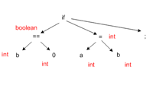
Semantics analysis
Check semantics
Error reporting
Disambiguate overloaded operators
Type coercion
Static checking :
Type checking
Control flow checking
Uniqueness checking
Name checks

Slide 4
Semantics analysis
Semantic analysis is a pass by a compiler that adds semantic information to the parse tree and performs certain checks based on this information.
It logically follows the parsing phase, in which the parse tree is generated, and logically precedes the code generation phase, in which (intermediate / target) code is generated. (In a compiler implementation, it may be possible to fold different phases into one pass.)
Typical examples of semantic information that is added and checked is
typing information ( type checking ) and
the binding of variables and function names to their definitions
( object binding ).
Sometimes also some early code optimization is done in this phase. For this phase the compiler usually maintains symbol tables in which it stores what each symbol (variable names, function names, etc.) refers to.

Slide 5
Things are done in Semantic Analysis:
Disambiguate Overloaded operators : If an operator is overloaded, one would like to specify the meaning of that particular operator because from one will go into code generation phase next.
Type checking : The process of verifying and enforcing the constraints of types is called type checking. This may occur either at compile-time (a static check) or run-time (a dynamic check). Static type checking is a primary task of the semantic analysis carried out by a compiler.
Uniqueness checking : Whether a variable name is unique or not, in the its scope.
Type coercion : If some kind of mixing of types is allowed which is generally done in the languages which are not strongly typed. This can be done dynamically as well as statically.
Name Checks : Check whether any variable has a name which is not allowed. Ex. Name is same as an identifier( Ex. int in java).

Slide 6
Beyond Parsing
Parser cannot catch all the program errors
There is a level of correctness that is deeper than syntax analysis
Some language features cannot be modeled using context free grammar formalism
Whether an identifier has been declared before use
A parser has its own limitations in catching program errors related to semantics, something that is deeper than syntax analysis.
Typical features of semantic analysis cannot be modeled using context free grammar formalism.
If one tries to incorporate those features in the definition of a language then that language doesn't remain context free anymore.

Slide 7
Beyond Parsing
Example 1
string x; int y;
y = x + 3
the use of x is a type error
Example 2
Int a, b;
a = b + c
c is not declared
Example 3
An identifier may refer to different variables in different parts of the program
An identifier x can be declared in two separate functions in the program, once of the type int and then of the type char. Hence the same identifier will have to be bound to these two different properties in the two different contexts.
Example4:
An identifier may be usable in one part of the program but not another
A variable declared within one function cannot be used within the scope of the definition of the other function unless declared there separately (in another scope).

Slide 8
What does a compiler need to know during semantic analysis? A few examples:
Whether a variable has been declared?
Are there variables which have not been declared?
What is the type of the variable? (int a, b , c; )
Whether a variable is a scalar, an array, or a function?
What declaration of the variable does each reference use?
If an expression is type consistent?
If an array use like A[i,j,k] is consistent with the declaration? Does it have three dimensions?
Then we see that syntax analyzer cannot alone handle this situation. We actually need to traverse
the parse trees to find out the type of identifier and this is all done in semantic analysis phase.

Slide 9
What does a compiler need to know during semantic analysis? Few more examples:
How many arguments does a function take?
Are all invocations of a function consistent with the declaration?
If an operator/function is overloaded, which function is being invoked?
Inheritance relationship
Classes not multiply defined
Methods in a class are not multiply defined
The exact requirements depend upon the language
If the compiler has the answers to all these questions only then will it be able to successfully do
a semantic analysis by using the generated parse tree. These questions give a feedback to what
is to be done in the semantic analysis. These questions help in outlining the work of the
semantic analyzer.

Slide 10
How to answer these questions?
Use formal methods
Context sensitive grammars
Extended attribute grammars
Use ad-hoc techniques
Symbol table
Ad-hoc code
Something in between !!!
Use attributes
Do analysis along with parsing - Use code for attribute value computation
However, code is developed in a systematic way

Slide 11
How to answer these questions?
In syntax analysis we used context free grammar. Here we put lot of attributes around it. So it consists of context sensitive grammars along with extended attribute grammars.
Ad-hoc methods also good as there is no structure in it and the formal method is simply just too tough. So we would like to use something in between.
Formalism may be so difficult that writing specifications itself may become tougher than writing compiler itself.
So we do use attributes but we do analysis along with parse tree itself instead of using context sensitive grammars.

Slide 12
Why attributes ?
For lexical analysis and syntax analysis formal techniques were used.
However, we still had code in form of actions along with regular expressions and context free grammar
The attribute grammar formalism is important
However, it is very difficult to implement
But makes many points clear
Makes "ad-hoc" code more organized
Helps in doing non local computations
Attribute grammar is nothing but it is a CFG and attributes put around all the
terminal and non-terminal symbols are used. Despite the difficulty in the
implementation of the attribute grammar formalism it has certain big
advantages which makes it desirable.

Slide 13
Attribute Grammar Framework
Generalization of CFG where each grammar symbol has an associated set of attributes
Values of attributes are computed by semantic rules
Two notations for associating semantic rules with productions
Syntax directed definition
high level specifications
hides implementation details
explicit order of evaluation is not specified
Syntax directed translation schemes
indicate order in which semantic rules are to be evaluated
allow some implementation details to be shown

Slide 14
Attribute Grammar Framework
There are two ways for writing attributes:
Syntax Directed Definition : A SDD specifies the values of attributes by associating semantic rules with the grammar rules. For example, an infix-to-postfix translator might have a production and rule
Production = { E → E₁ + T}
Semantic rule = { E.code = E₁.code || T.code || ‘+’}
Syntax-directed Translation scheme : A SDT scheme embeds program fragments called semantic actions within production bodies
E → E₁ + T {print ‘+’}

Slide 15
Attribute Grammar Framework
Conceptually both:
parse input token stream
build parse tree
traverse the parse tree to evaluate the semantic rules at the parse tree nodes
Evaluation may:
generate code
save information in the symbol table
issue error messages
perform any other activity
To avoid repeated traversal of the parse tree, actions are taken simultaneously when a token is found. So calculation of attributes goes along with the construction of the parse tree.
Along with the evaluation of the semantic rules the compiler may simultaneously generate code, save the information in the symbol table, and / or issue error messages etc. at the same time while building the parse tree.
This saves multiple passes of the parse tree.

Slide 16
Syntax Directed Definition
A syntax-directed definition is a generalization of a context-free grammar in which:
– Each grammar symbol is associated with a set of attributes.
– This set of attributes for a grammar symbol is partitioned into
two subsets called
synthesized attributes and
inherited attributes of that grammar symbol.
– Each production rule is associated with a set of semantic rules.
Semantic rules set up dependencies between attributes which can be
represented by a dependency graph.
This dependency graph determines the evaluation order of these
semantic rules.
Evaluation of a semantic rule defines the value of an attribute. But a semantic rule may also have some side effects such as printing a value.

Slide 17
Example:
Number → sign list
sign → + | -
list → list bit | bit
bit → 0 | 1
Build attribute grammar that annotates Number with the value it represents
Associate attributes with grammar symbols
symbol attributes
Number value
sign negative
list position, value
bit position, value

Slide 18
Example:
Production | Attribute rule | Explanations
number → sign list | list.position ← 0 if sign.negative then number.value ← - list.value else number.value ← list.value | /*since list is the rightmost so it is assigned position 0 */ /*Sign determines whether the value of the number would be same or the negative of the value of list*/
sign → + sign → - | sign.negative ← false sign.negative ← true | /*Set the Boolean attribute (negative) for sign*/
list → bit | bit.position ← list.position list.value ← bit.value | /*bit position is the same as list position because this bit is the rightmost*/ /*value of the list is same as bit.*/
list₀ → list ₁ bit | list₁ .position ← list ₀ .position + 1 bit.position ← list ₀ .position list₀ .value ← list₁ .value + bit.value | /*position and value calculations*/
bit → 0 bit → 1 | bit.value ← 0 bit.value ← 2^{bit.position} | /*set the corresponding value*/
Note: Attributes of RHS can be computed from attributes of LHS and vice versa.

Slide 19
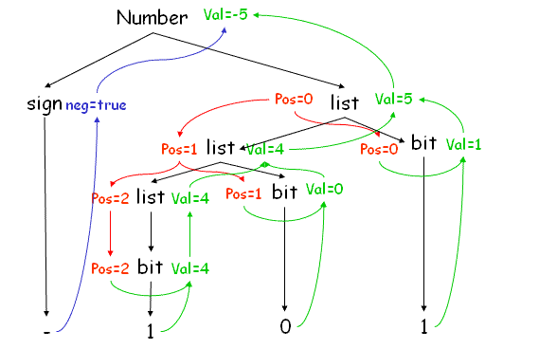
Dependency Graph:
Dependence graph shows the dependence of attributes on other attributes, along with the syntax tree. Top down traversal is followed by a bottom up traversal to resolve the dependencies.

Slide 20
Attributes:
attributes fall into two classes:
synthesized:
value of a synthesized attribute is computed from the values of its children nodes
inherited:
value of an inherited attribute is computed from the sibling and parent nodes
The synthesized attributes are the result of the attribute evaluation rules also using the values of the inherited attributes.
The values of the inherited attributes are inherited from parent nodes and siblings.

Slide 21
Dependency Graph:
Number, val and neg are synthesized attributes. Pos is an inherited attribute.

Slide 22
Attributes:
Each grammar production A→ α has associated with it a set of semantic rules of the form
b = f (c₁ , c₂ , ..., c_{k} )
where f is a function, and b can be one of the following:
b is a synthesized attribute of A and c1,c2,…,ck are attributes of the grammar
symbols in the production ( A → α) OR
b is an inherited attribute of one of the grammar symbols in α (on the right side of the production) and attribute b depends on attributes c₁ , c₂ , ..., c_{k}
Dependence relation tells us what attributes we need to know before hand to calculate a particular attribute.
Here the value of the attribute b depends on the values of the attributes c₁ to c_{k}. If c₁ to c_{k} belong to the children nodes and b to A then b will be called a synthesized attribute.
And if b belongs to one among a (child nodes) then it is an inherited attribute of one of the grammar symbols on the right.

Slide 23
Synthesized Attributes
A syntax directed definition that uses only synthesized attributes is said to be an S- attributed definition
A parse tree for an S-attributed definition can be annotated by evaluating semantic rules for attributes
S-attributed grammars are a class of attribute grammars, comparable with L-attributed grammars but characterized by having no inherited attributes at all.
Attribute evaluation in S-attributed grammars can be incorporated conveniently in both top-down parsing and bottom-up parsing .

Slide 24
Syntax-Directed Definition -- Example
L E n | Print (E.val)
E E + T | E.val = E.val + T.val
E T | E.val = T.val
T T * F | T.val = T.val * F.val
T F | T.val = F.val
F (E) | F.val = E.val
F digit | F.val = digit.lexval
Terminals are assumed to have only synthesized attribute values of which are
supplied by lexical analyzer
Start symbol does not have any inherited attribute
This is a grammar which uses only synthesized attributes. Start symbol has no parents, hence no inherited attributes.

Slide 25
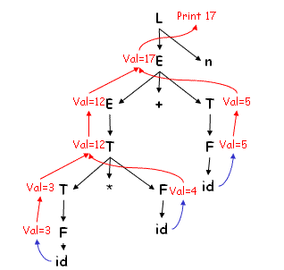
Annotated Parse tree for 3 * 4 + 5 n (Bottom up parsing)
Values of lexval is supplied by lexical analyzer
Each node (nonT) has attribute val which is computed in bottom up order
At the node with a child level *, after computing T.val =3 and f.val=5 at its first and third children, we apply the rule that says T.val is the product of these two values or 15.
Dependency graph is also shown in Blue and red lines.

Slide 26
Inherited Attributes
An inherited attribute is one whose value is defined in terms of attributes at the parent and/or siblings
Inherited attributes help to find the context (type, scope etc.) of a token e.g., the type of a token or scope when the same variable name is used multiple times in a program in different functions
Let take an example.

Slide 27
Example: Inherited Attributes
Production ID | Production Rules | Semantic Rules associated with each production
p1 | D → T L | L.inh = T.type
p2 | T → float | T.type = float
p3 | T → int | T.type = integer
p4 | L → L₁ , id | L₁.inh = L.inh addtype (id.entry, L.inh)
p5 | L → id | addtype (id.entry,L.inh)
The above SDD takes a simple declaration D consisting of a basic type T followed by a list of L of identifiers. T can be int or float
Nonterminal D represents a declaration (p1) consists of a type T followed by a list of L identifiers.
T has one attributes, T.type, which is the type in the declaration D.
Nonterminal L has also one inherited attribute (inh → inherited). The purpose of L.inh is to pass the declared type down the list of identifiers, so that it can be added to the appropriate symbol table entries.

Slide 28
Example: Inherited Attributes
Production ID | Production Rules | Semantic Rules associated with each production
p1 | D → T L | L.inh = T.type
p2 | T → float | T.type = float
p3 | T → int | T.type = integer
p4 | L → L₁ , id | L₁.inh = L.inh addtype (id.entry, L.inh)
p5 | L → id | addtype (id.entry,L.inh)
Each of p2 and p3 evaluate the synthesized attribute T.type (int or float). This type is passed to the attribute L.inh semantic rule with p1.
p4 passes L.inh down the parse tree i.e L1.inh is computed at a parse tree node by copying the value of L.inh from the parent of that node; the parent corresponds to the head of the production.
P4 and p5 have a rule in which func. addType is called with two arguments
Id.entry → a lexical value that points to a symbol table objects
L.inh, the type being assigned to every identifier on the list

Slide 29
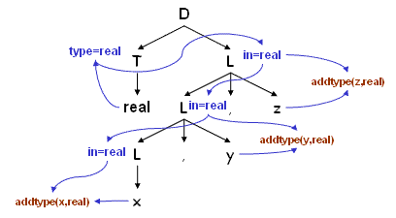
Example: Parse tree for real x, y, z Dependence of attributes in an inherited attribute system.
5
6
4
3
7
8
2
9
10
1
1 to 10 denotes nodes of the dependency graph
Nodes 1,2,3 represents attributes entry with ids (x,y,z)
6,8,10 are the dummy attributes that represents the application of the function addType to a type and one of these entry values.
Node 4 represents the attribute T.type where evaluation begins. This type is then passed to node 5, 7and 9 representing L.inh associated with each of the occurrences' of the non terminal L

Slide 30
Dependency Graph
If an attribute b depends on an attribute c then the semantic rule for b must be evaluated after the semantic rule for c
The dependencies among the nodes can be depicted by a directed graph called dependency graph
Dependency Graph : Directed graph indicating interdependencies among the synthesized and inherited attributes of various nodes in a parse tree.

Slide 31
Algorithm to construct dependency graph
for each node n in the parse tree do
for each attribute a of the grammar symbol do
construct a node in the dependency graph
for a
for each node n in the parse tree do
for each semantic rule b = f (c₁ , c₂ , ..., c_{k} ) do
{ associated with production at n }
for i = 1 to k do
construct an edge from c_{i} to b
An algorithm to construct the dependency graph. After making one node for every attribute of all the nodes of the parse tree, make one edge from each of the other attributes on which it depends.

Slide 32
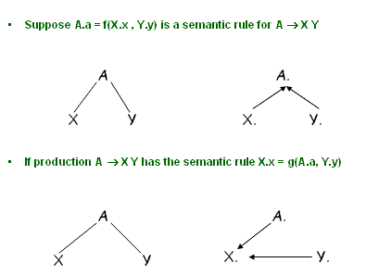
Example
The semantic rule A.a = f(X.x , Y.y) for the production A -> XY defines the synthesized attribute a of A to be dependent on the attribute x of X and the attribute y of Y . Thus the dependency graph will contain an edge from X.x to A.a and Y.y to A.a accounting for the two dependencies. Similarly for the semantic rule X.x = g(A.a , Y.y) for the same production there will be an edge from A.a to X.x and an edge from Y.y to X.x.

Slide 33
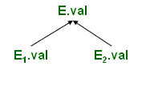
Example
Whenever following production is used in a parse tree
E → E 1 + E 2 E.val = E 1 .val + E 2 .val
we create a dependency graph
The synthesized attribute E.val depends on E1.val and E2.val hence the two edges one each from E 1 .val & E 2 .val

Slide 34
Example
dependency graph for real id1, id2, id3
put a dummy synthesized attribute b for a semantic rule that consists of a procedure call
5
6
4
3
7
8
2
9
10
1
The figure shows the dependency graph for the statement real id1, id2, id3 along with the parse tree. Procedure calls can be thought of as rules defining the values of dummy synthesized attributes of the nonterminal on the left side of the associated production. Blue arrows constitute the dependency graph and black lines, the parse tree. Each of the semantic rules addtype (id.entry, L.in) associated with the L productions leads to the creation of the dummy attribute.

Slide 35
Evaluation Order
Any topological sort of dependency graph gives a valid order in which semantic rules must be evaluated
a4 = real
a5 = a4
addtype(id3.entry, a5)
a7 = a5
addtype(id2.entry, a7 )
a9 := a7 addtype(id1.entry, a9 )
5
6
4
3
7
8
2
9
10
1
A topological sort of a directed acyclic graph is any ordering m1, m2, m3 ..... mk of the nodes of the graph such that edges go from nodes earlier in the ordering to later nodes. Thus if mi -> mj is an edge from mi to mj then mi appears before mj in the ordering. The order of the statements shown in the slide is obtained from the topological sort of the dependency graph in the previous slide. 'an' stands for the attribute associated with the node numbered n in the dependency graph. The numbering is as shown in the previous slide.

Slide 36
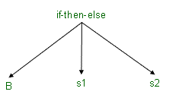
Abstract Syntax Tree
Condensed form of parse tree
Useful for representing language constructs.
The production S if B then s1 else s2 may appear as

Slide 37
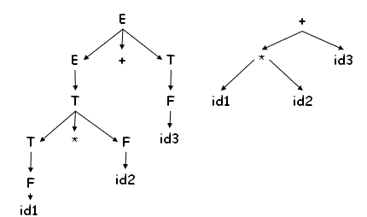
Abstract Syntax tree
Operators and keywords do not appear as leaves, rather they are associated with the interior node that would be parent of those leaves in the parse tree.
Chain of single productions may be collapsed

Slide 38
Constructing Abstract Syntax tree for expression
Each node can be represented as a record
operators : one field for operator, remaining fields ptrs to operands mknode( op,left,right )
identifier : one field with label id and another ptr to symbol table mkleaf(id,entry)
number : one field with label num and another to keep the value of the number
mkleaf(num,val)
Each node in an abstract syntax tree can be implemented as a record with several fields.
In the node for an operator one field identifies the operator (called the label of the node) and the remaining contain pointers to the nodes for operands.
Nodes of an abstract syntax tree may have additional fields to hold values (or pointers to values) of attributes attached to the node.
The functions given in the slide are used to create the nodes of abstract syntax trees for expressions. Each function returns a pointer to a newly created note.

Slide 39
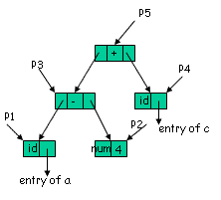
Example
the following
sequence of function
calls creates a parse
tree for a- 4 + c using bottom-up parsing
P 1 = mkleaf(id, entry.a)
P 2 = mkleaf(num, 4)
P 3 = mknode(-, P 1 , P 2 )
P 4 = mkleaf(id, entry.c)
P 5 = mknode(+, P 3 , P 4 )

Slide 40
Example
An example showing the formation of an abstract syntax tree by the given function calls for the expression a-4+c.The call sequence can be explained as:
P1 = mkleaf(id,entry.a) : A leaf node made for the identifier “a” and an entry for
“a” is made in the symbol table.
P2 = mkleaf(num,4) : A leaf node made for the number “4”.
P3 = mknode(-,P1,P2) : An internal node for the “-”. It takes the previously made nodes as arguments and represents the expression “a-4”.
P4 = mkleaf(id,entry.c) : A leaf node made
for the identifier “c” and an entry for “c” is made
in the symbol table.
P5 = mknode(+,P3,P4) : An internal node for the
“+”. It takes the previously made nodes as arguments
and represents the expression “a- 4+c”.

Slide 41
A syntax directed definition for constructing syntax tree for an expression
E → E₁ + T | E.ptr = mknode(+, E₁. ptr, T.ptr)
E → T | E.ptr = T. ptr
T → T₁ * F | T.ptr := mknode(*, T₁. ptr, F.ptr)
T → F | T.ptr := F. ptr
F → (E) | F.ptr := E. ptr
F → id | F.ptr := mkleaf(id, id.entry)
F → num | F.ptr := mkleaf(num, num.val)
Now we have the syntax directed definitions to construct the parse tree for a given grammar.

Slide 42
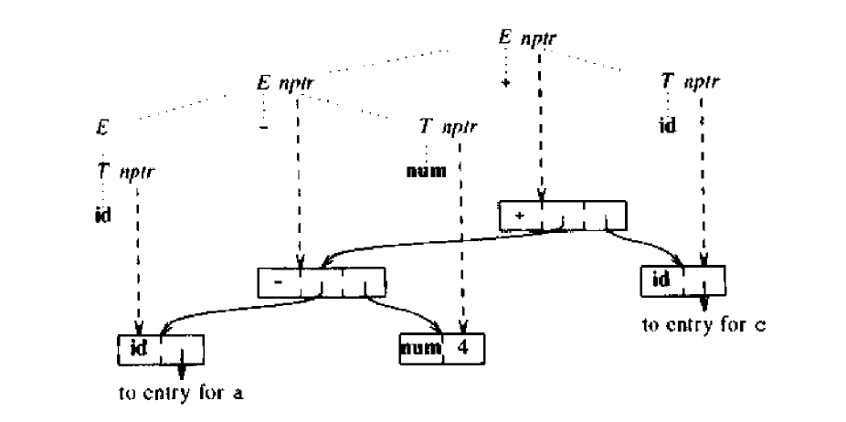
Construction of a syntax tree for a-4+c

Slide 43
Directed Acyclic Graph (DAG) for Expression
A DAG has leaves corresponding to atomic operands and interior codes corresponding to operators.
The difference is that a node N in a DAG has more than one parent if N represents a common sub-expression.
In a syntax tree, the tree for the common sub expression would be replicated as many times as the sub-expression appears in the original expression.
Thus, a DAG not only represents expressions more succinctly, it gives the compiler important clues regarding the generation of efficient code to evaluate the expressions.

Slide 44
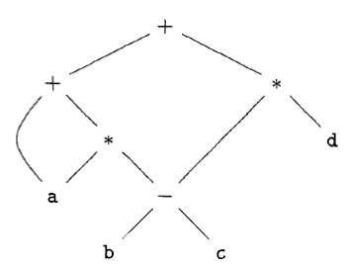
DAG for the expression a + a * (b - c) + (b - c) * d
+
*
+
-
d
a
*
b
c
a
-
b
c
DAG
Abstract Syntax Tree

Slide 45
DAG for the expression
E → E₁ + T | E.ptr = mknode(+, E₁. ptr, T.ptr)
E → T | E.ptr = T. ptr
T → T₁ * F | T.ptr := mknode(*, T₁. ptr, F.ptr)
T → F | T.ptr := F. ptr
F → (E) | F.ptr := E. ptr
F → id | F.ptr := mkleaf(id, id.entry)
F → num | F.ptr := mkleaf(num, num.val)
The above SDD can construct either syntax trees or DAG 's.
It was used to construct syntax trees in previously where functions Leaf and Node created a fresh node each time they were called.
It will construct a DAG if, before creating a new node, these functions first check whether an identical node already exists. If a previously created identical node exists, the existing node is returned.
For instance, before constructing a new node, Node( op, left, right) , we check whether there is already a node with label op, and children left and right, in that order. If so, Node returns the existing node; otherwise, it creates a new node .

Slide 46
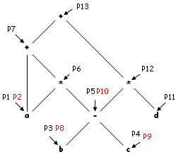
Dag for Expression
P 1 = makeleaf(id,a)
P 2 = makeleaf(id,a)
P 3 = makeleaf(id,b)
P 4 = makeleaf(id,c)
P 5 = makenode(-,P 3 ,P 4 )
P 6 = makenode(*,P 2 ,P 5 )
P 7 = makenode(+,P 1 ,P 6 )
P 8 = makeleaf(id,b)
P 9 = makeleaf(id,c)
P 10 = makenode(-,P 8 ,P 9 )
P 11 = makeleaf(id,d)
P 12 = makenode(*,P 10 ,P 11 )
P 13 = makenode(+,P 7 ,P 12 )

Slide 47
Dag for Expression
A directed acyclic graph (DAG) for the expression : a + a * (b V c) + (b V c) * d.
All the function calls are made as in the order shown. Whenever the required node is already present, a pointer to it is returned so that a pointer to the old node itself is obtained. A new node is made if it did not exist before. The function calls can be explained as:
P1 = makeleaf(id,a)
A new node for identifier Qa R made and pointer P1 pointing to it is returned.
P2 = makeleaf(id,a)
Node for Qa R already exists so a pointer to that node i.e. P1 returned.
P3 = makeleaf(id,b)
A new node for identifier Qb R made and pointer P3 pointing to it is returned.
P4 = makeleaf(id,c)
A new node for identifier Qc R made and pointer P4 pointing to it is returned.
P5 = makenode(-,P3,P4)
A new node for operator Q- R made and pointer P5 pointing to it is returned. This node becomes the parent of P3,P4.
P6 = makenode(*,P2,P5)
A new node for operator Q- R made and pointer P6 pointing to it is returned. This node becomes the parent of P2,P5.

Slide 48
Dag for Expression
P7 = makenode(+,P1,P6)
A new node for operator Q+ R made and pointer P7 pointing to it is returned. This node becomes the parent of P1,P6.
P8 = makeleaf(id,b)
Node for Qb R already exists so a pointer to that node i.e. P3 returned.
P9 = makeleaf(id,c)
Node for Qc R already exists so a pointer to that node i.e. P4 returned.
P10 = makenode(-,P8,P9)
A new node for operator Q- R made and pointer P10 pointing to it is returned. This node becomes the parent of P8,P9.
P11 = makeleaf(id,d)
A new node for identifier Qd R made and pointer P11 pointing to it is returned.
P12 = makenode(*,P10,P11)
A new node for operator Q* R made and pointer P12 pointing to it is returned. This node becomes the parent of P10,P11.
P13 = makenode(+,P7,P12)
A new node for operator Q+ R made and pointer P13 pointing to it is returned. This node becomes the parent of P7, P12.

Slide 49

Bottom-up evaluation of S-attributed definitions
Can be evaluated while parsing.
Whenever reduction is made, value of new synthesized attribute is computed from the attributes on the stack
Extend stack to hold the values also
The current top of stack is indicated by ptr top
Synthesized attributes are evaluated using the attributes of the children nodes only.
So in a bottom up evaluation, if the attributes are maintained on a stack then the attributes of nodes higher up in the parse tree can be evaluated.
The stack is extended to hold the state as well as the value.
Top of the stack is maintained in a location pointed by the pointer top.

Slide 50
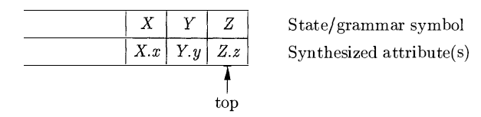
Bottom-up evaluation of S-attributed definitions
Suppose semantic rule A.a = f(X.x, Y.y, Z.z) is associated with production A → XYZ
Before reducing XYZ to A, value of Z is in val(top), value of Y is in val(top-1) and value of X is in val(top-2)
If symbol has no attribute then the entry is undefined
After the reduction, top is decremented by 2 and state covering A is put in val(top)
An example of a parser stack while parsing of A.a := f( X.x,Y.y,Z.z).
Top is decremented by two because three values viz. X,Y and Z are popped and value of A has to be pushed in.

Slide 51
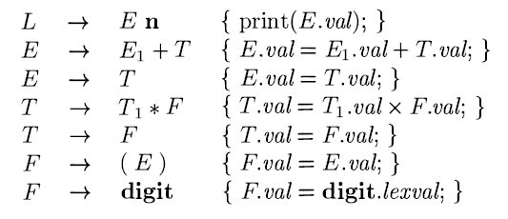
Example: desk calculator

Slide 52
Example: desk calculator
Suppose that the stack is kept in an array of records called stack, with top a cursor to the top of the stack. Thus, stack[ top] refers to the top record on the stack, stack[ top - 1] to the record below that, and so on.
Also, we assume that each record has a field called val, which holds the attribute of whatever grammar symbol is represented in that record. Thus, we may refer to the attribute E.val that appears at the third position on the stack as stack[ top - 2] . val.
For instance, in the second production, E → E₁ + T, we go two positions below the top to get the value of E₁ , and we find the value of T at the top. The resulting sum is placed where the head E will appear after the reduction, that is, two positions below the current top. The reason is that after the reduction, the three topmost stack symbols are replaced by one.
After computing E. val, we pop two symbols off the top of the stack, so the record where we placed E. val will now be at the top of the stack.

Slide 53
Example: desk calculator
Before reduction ntop = top - r +1 where ntop is a temporary variable
After code reduction top = ntop
The code fragments (like val(ntop) = val(top-1) ) in the implementation of the desk calculator
When a production with r symbols on then right side is reduced, the value of ntop is set to top - r + 1 . After each code fragment is executed, top is set to ntop .

Slide 54
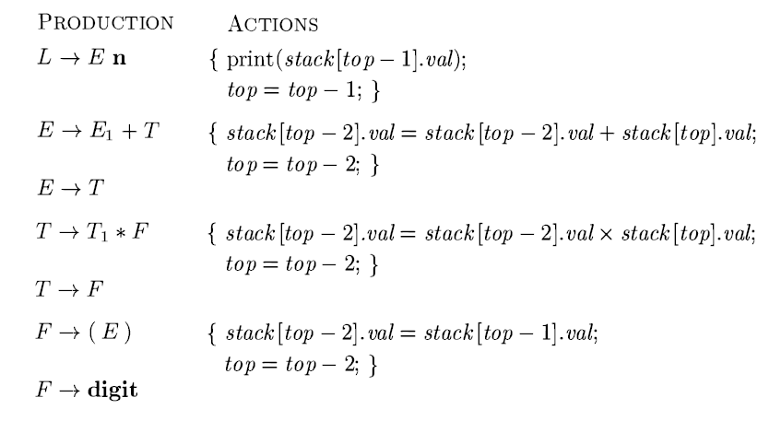
Example: desk calculator

Slide 55
Example: desk calculator
Evaluation of the synthesized attributes of 3*5+4n by an LR parser during a bottom up pass.
Initial sequence of events on seeing the input : The parser shifts the state corresponding to token digit (taken as digit here) onto the stack.
In the second move, the parser reduces by the production F -> digit. It implements the semantic rule F.val = digit.lexval.
In the third move, the parser reduces by T -> F. No code fragment is associated so the val array is unchanged.
Rest of the implementation goes on similar lines. After each reduction, the top of the val stack contains the attribute value associated with the left side of the reducing production.

Slide 56
Example: desk calculator
INPUT | STATE | Val | PRODUCTION
3*5+4n
*5+4n | digit | 3
*5+4n | F | 3 | F → digit
*5+4n | T | 3 | T → F
5+4n | T* | 3 -
+4n | T*digit | 3 - 5
+4n | T*F | 3 - 5 | F → digit
+4n | T | 15 | T → T * F
+4n | E | 15 | E → T
4n | E+ | 15 -
n | E+digit | 15 - 4
n | E+F | 15 - 4 | F → digit
n | E+T | 15 - 4 | T → F
n | E | 19 | E → E +T

Slide 57
Semantic Analysis
End of part I

Slide 59
Example
number → sign list | list.position ← 0
 | if sign.negative then
 | number.value ← - list.value
 | else
 | number.value ← list.value
sign → + | sign.negative ← false
sign → - | sign.negative ← true
list → bit | bit.position ← list.position
 | list.value ← bit.value
list ₀ → list ₁ bit | list ₁ .position ← list ₀ .position + 1
 | bit.position ← list ₀ .position
 | list ₀ .value ← list ₁ .value + bit.value
bit →0 | bit.value ← 0
bit →1 | bit.value ← 2 ^{bit.position}
Extend the scheme which has a rule number → sign list .
List replacing number → sign list

